Slide 1
Capstone Project- The Battle of the Neighborhoods

Slide 2
Efficient Decision on selecting A neighborhood in north york
The purpose of this Capstone Project is to help people in exploring better facilities around their neighborhood. It will help people making smart and efficient decision on selecting great neighborhood out of numbers of other neighborhoods in North York, Toranto.
Lots of people are migrating to various states of Canada and needed lots of research for good housing prices and reputated schools for their children. This project is for those people who are looking for better neighborhoods. For ease of accessing to Cafe, School, Super market, medical shops, grocery shops, mall, theatre, hospital, like minded people, etc.

Slide 3
This Capstone Project aim to create an analysis of features for a people migrating to North York to search a best neighborhood as a comparative analysis between neighborhoods. The features include median housing price and better school according to ratings, crime rates of that particular area, road connectivity, weather conditions, good management for emergency, water resources both freash and waste water and excrement conveyed in sewers and recreational facilities.
It will help people to get awareness of the area and neighborhood before moving to a new city, state, country or place for their work or to start a new fresh life

Slide 4
Data and cleaning
To consider the objective stated above, we can list the below data sources used for the analysis.
Toronto Neighborhood Data: The following Wikipedia page was scraped to pull out the necessary information: https://en.wikipedia.org/wiki/List_of_postal_codes_of_Canada:_M
b) Coordinate data for each Neighborhood in Toronto: The following csv file gave us the geographical coordinates of each postal code: http://cocl.us/Geospatial_data

Slide 5
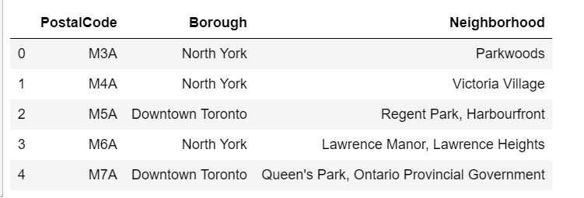
Methodology:
1. Scrape the Wikipedia page and gathering data into a Pandas dataframe

Slide 6
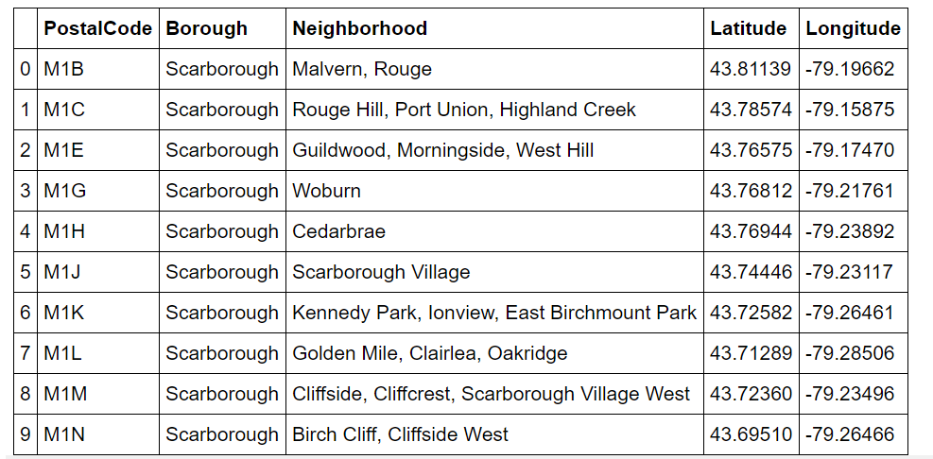
Next, combined both the dataframes by adding the coordinate data to the original dataframe.

Slide 7
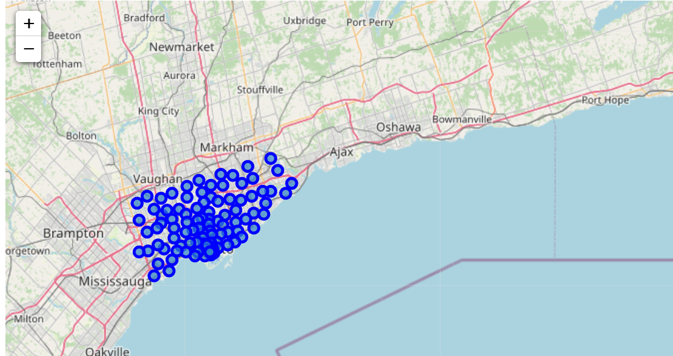
Generating a map of Toronto and plotting the Neighborhood data
We then use the python folium library to visualize geographic details of Toronto and its boroughs. I created a map of Toronto with boroughs superimposed on top using the latitude and longitude values to get the visual as below:

Slide 8
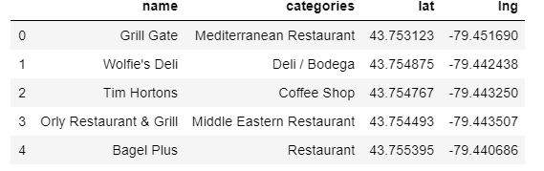
Utilizing Foursquare API to explore the neighborhoods
Next, we are going to start utilizing the Foursquare API to explore the neighborhoods and segment them.
Here is a head of the list of Nearby Venues for the first neighborhood

Slide 9
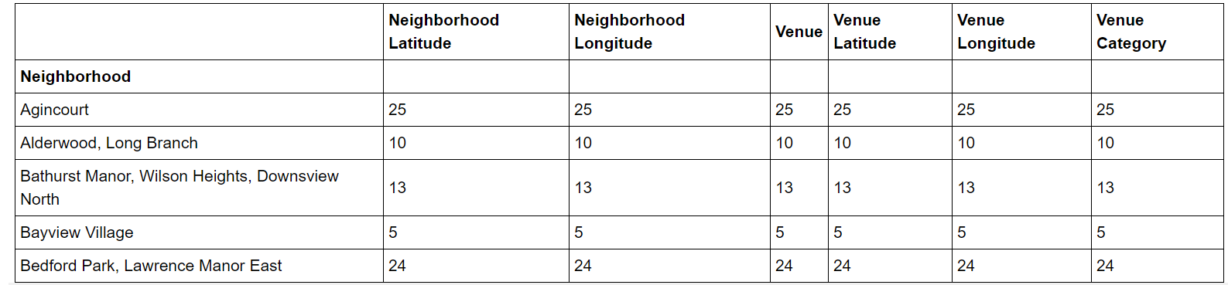
We create a new function that will repeat the process above for all the neighborhoods in Toronto. This function will give us a list of all venues present in Toronto city. Here is a head () value of this dataframe.

Slide 10
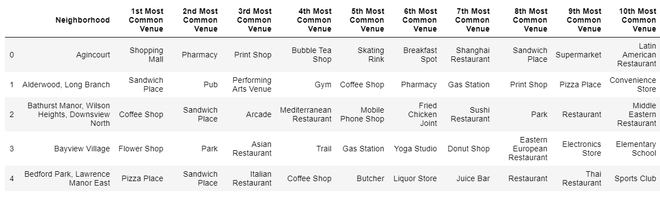
Analyze each neighborhood
We use One Hot Encoding, use the neighborhood to group data, and find out the top ten venues present in each neighborhood

Slide 11
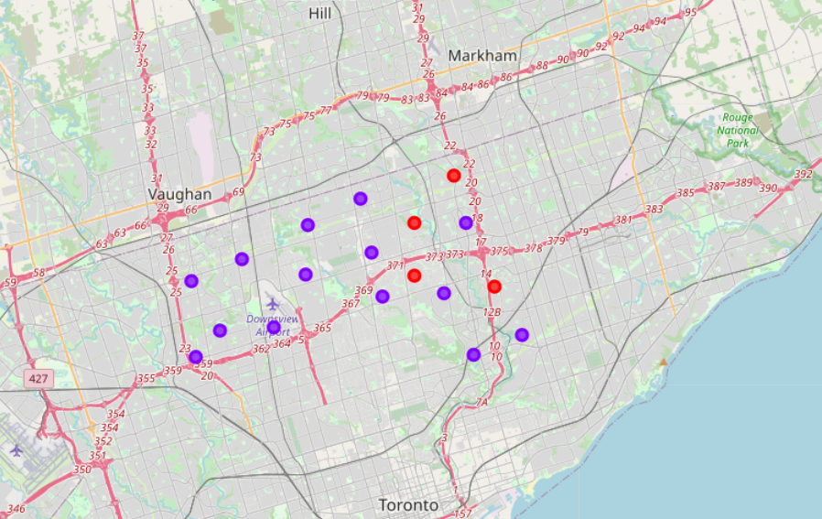
. Visualizing the resulting Clusters
We use the matplotlib and folium packages to visualize the clusters on a map of Toronto

Slide 12
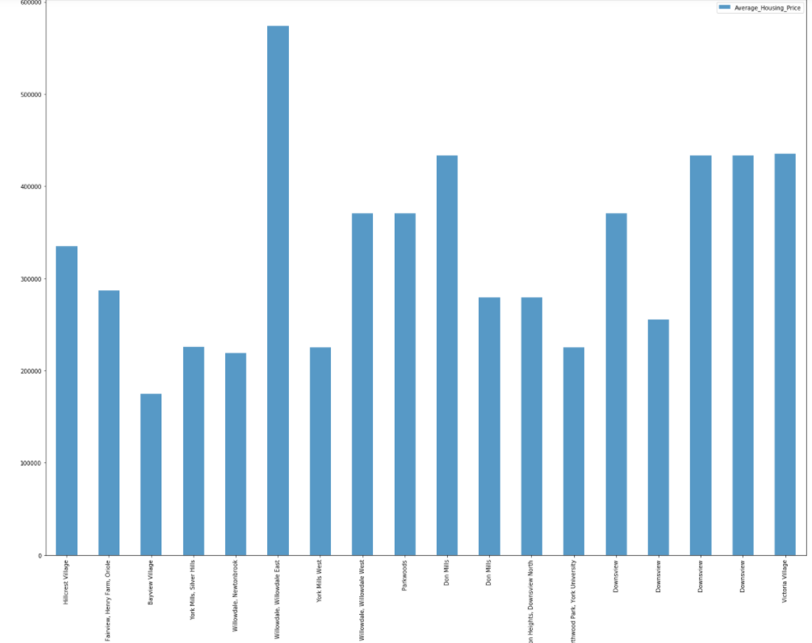
Average Housing Price by Clusters in North York

Slide 13
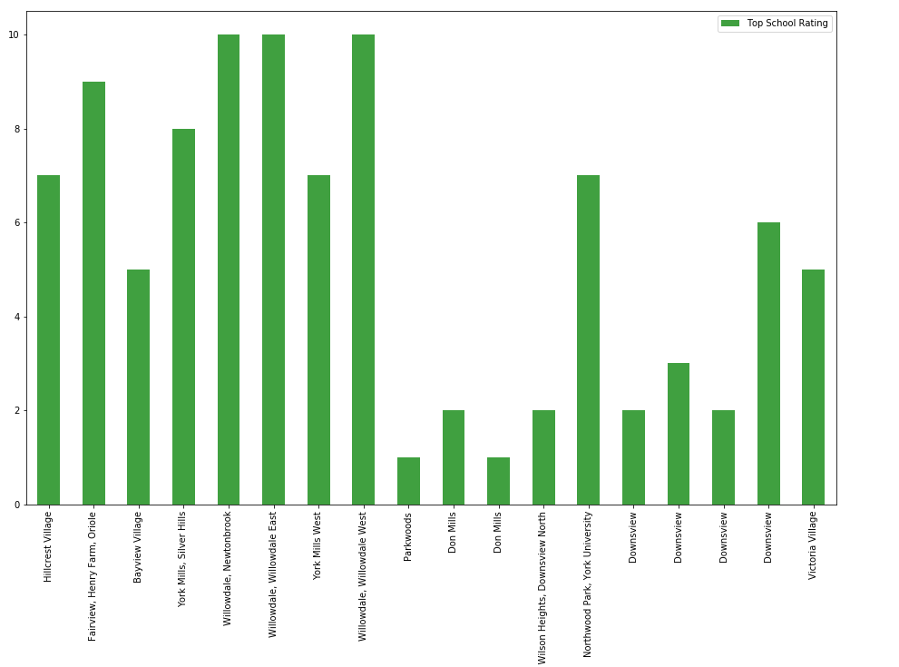
School Ratings by Clusters in North York

Slide 14
Conclusion
In this Capstone project, using k-means cluster algorithm I separated the neighborhood into 2 different clusters and for 103 different lattitude and longitude from dataset, which have very-similar neighborhoods around them.
Using the charts above results presented to a particular neighborhood based on average house prices and school rating have been made.

